Slide 1
Cables and Connectors
Course Code: CSC 3116
Course Title: Computer Networks
Dept. of Computer Science
Faculty of Science and Technology
Lecturer No: | Lab 4 | Week No: | 4 | Semester: | Fall 23-24
Lecturer: | Dr. Mehedi Hasan; mmhasan@aiub.edu

Slide 2
Lecture Outline
Different types of devices
Ethernet Cabling
Terminal Emulation Software
Remote Access

Slide 3
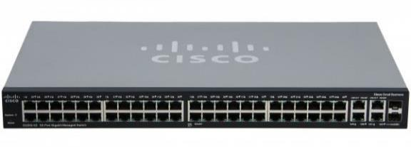
Cisco Switch
Fig. A 2960 series cisco switch

Slide 4
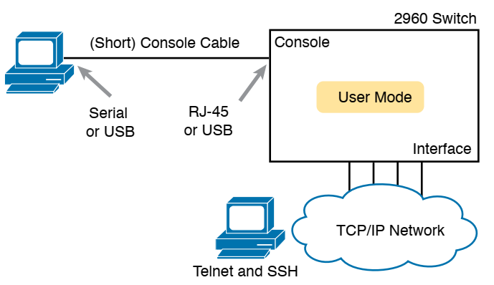
CLI access options
Fig. CLI access options

Slide 5
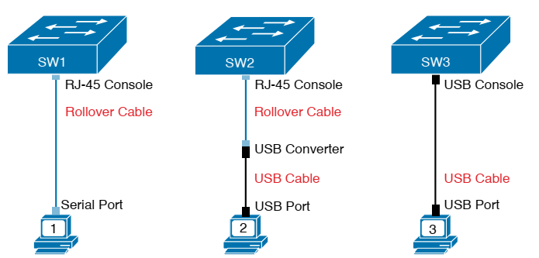
Console Connection to Switch
2960-XR series
supports both
the older RJ-45
console port
and a USB
console port
USB
console port is
Not rectangular
,rather it is
Mini-B port
Fig. Console Connection to a Switch

Slide 6
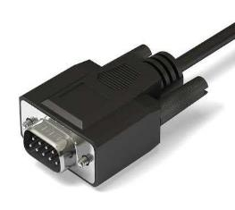
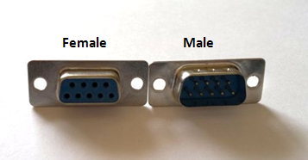
DB9 Connector
Almost obsolete
Replaced by USB
Fig. DB9 Connector (For serial port of PC)

Slide 7
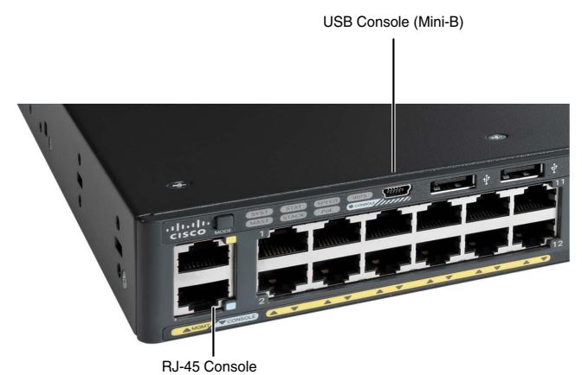
USB and RJ-45 Consle

Slide 8
Terminal Emulation Software
To interact with Switch/Routers
Examples
  SecureCRT: Supports serial, Telnet and SSH → Not free
  PuTTY: Supports serial, Telnet and SSH → free
  TeraTerm Pro: Supports serial, Telnet and SSH → free
  Windows Telnet (integrated to Windows OS) → Supports Telnet only
  Windows HyperTerminal → Supports Telnet and Serial, NOT SSH

Slide 9
Remote Access
Telnet and SSH allows remote access to Switch/Router
Must need password to access the device
Telnet is not secure
  No encryption
SSH is secure
  Encryption is used

Slide 10
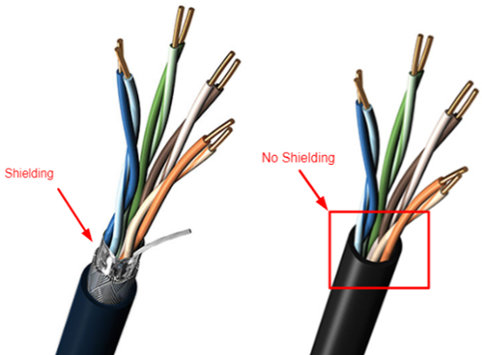
Ethernet cabling
  Unshielded Twisted Pair (UTP)
    Electromagnetic interference
    Less data rate
    cheap
  Shielded Twisted Pair (STP)
    Less interference
    Higher data rate
    costly

Slide 11
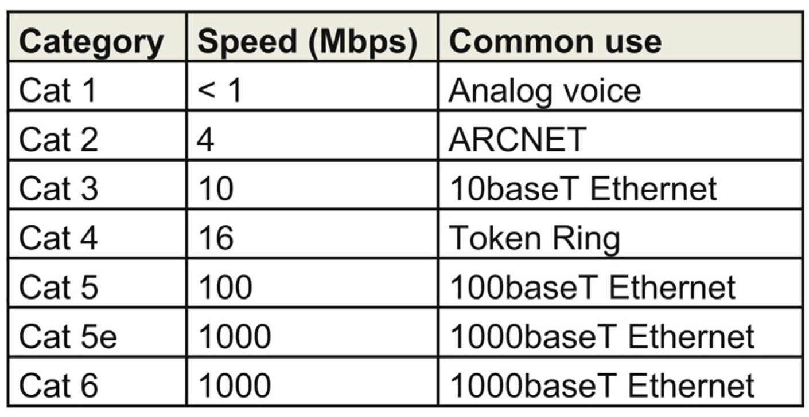
Ethernet cabling (contd…)
Table I Different categories of cable

Slide 12
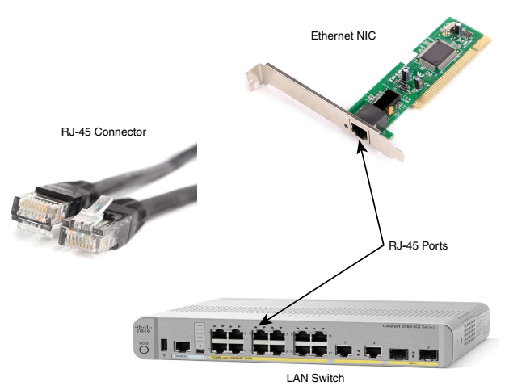
Ethernet cabling (contd…)

Slide 13

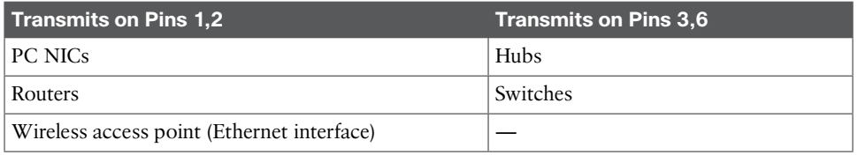
Ethernet cabling (contd…)
Straight-Through cable
  PC to Switch or Hub
  Router to Switch or Hub
Crossover cable
  PC to PC
  Switch to Switch
  Hub to Hub
  Switch to Hub
  Router to Router
  Router to PC
Rollover
  PC to Console

Slide 14
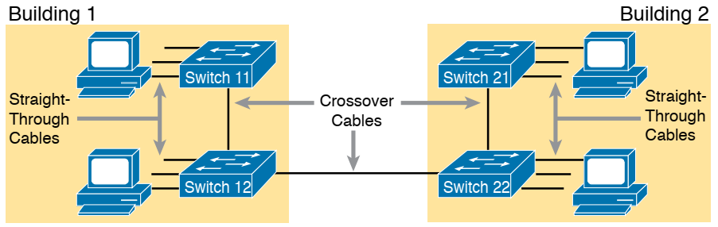
Ethernet cabling (contd…)

Slide 15
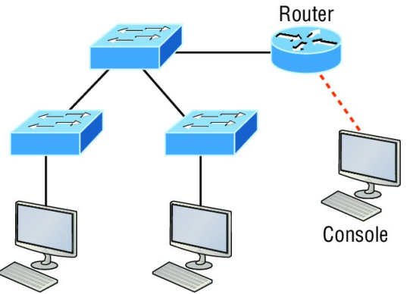
Ethernet cabling (contd…)
Identify cables

Slide 16
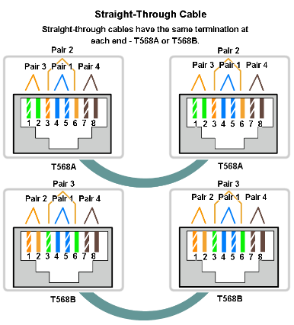
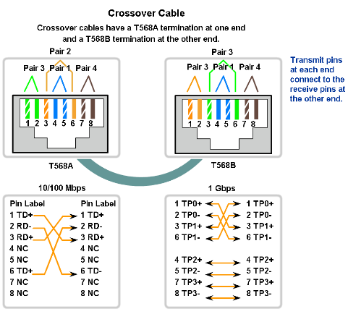
Ethernet cabling (contd…)

Slide 17
Suppose that we have three networks BBA, CSE, and EEE with IP requirements of 100, 350 and 80.
If You are given an IP block 10.10.0.0, allocate IPs performing subnetting.
Suppose that we have five networks A, B, C, D, and E with IP requirements of 10, 30, 90, 200, and 80.
If You are given an IP block 172.16.0.0, allocate IPs performing subnetting.
Consider your ID: AB-CDEFG-H, Suppose that we have four networks N1, N2, N3, and N4 with IP requirements of 100*C, 10*D, 50*A, and 20*G.
If You are given an IP block 192.168.0.0, allocate IPs performing subnetting.

Slide 18
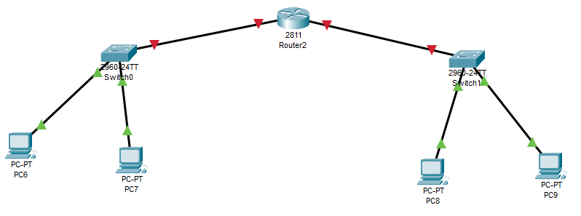
Suppose that we have two networks CSE and EEE with IP requirements of 10 and 8.
If You are given an IP block 192.168.0.0, allocate IPs performing subnetting.
192.168.0.14
255.255.255.240
192.168.0.22
255.255.255.248
192.168.0.1
255.255.255.240
192.168.0.14
192.168.0.2
255.255.255.240
192.168.0.14
192.168.0.18
255.255.255.248
192.168.0.22
192.168.0.17
255.255.255.248
192.168.0.22

Slide 19
Suppose that we have two networks CSE and EEE with IP requirements of 10 and 8.
If You are given an IP block 192.168.0.0, allocate IPs performing subnetting.
192.168.0.0/16
CSE→ 10 host → 4bit →192.168.0.0-15/28 → 255.255.255.240
Net address: 192.168.0.0/28
BC address: 192.168.0.15/28
Gateway: 192.168.0.14/28
EEE→ 8 host →3bit→192.168.0.16-23/29 → 255.255.255.248
Net address: 192.168.0.16/29
BC address: 192.168.0.23/29
Gateway: 192.168.0.22/29
RN-> 4 IP -> 2bit ->
192.168.0.24~27/30
255.255.255.252

Slide 20
References
  1. Official Cert Guide CCNA 200-301 , vol. 1, W. Odom, Cisco Press, First Edition, 2019, USA.
  2. CCNA Routing and Switching, T. Lammle, John Wily & Sons, Second Edition, 2016, USA.
  3. Cisco IOS Configuration Fundamentals Command Reference.
  http://www.cisco.com

Slide 21
Books
  1. Official Cert Guide CCNA 200-301 , vol. 1, W. Odom, Cisco Press, First Edition, 2019, USA.
  2. CCNA Routing and Switching, T. Lammle, John Wily & Sons, Second Edition, 2016, USA.

